Slide 2
20
Long-Run and Short-Run
Concerns: Growth, Productivity, Unemployment, and Inflation
Chapter Outline
Long-Run Output and Productivity
Growth
Recessions, Depressions, and
Unemployment
Defining and Measuring
Unemployment
Components of the Unemployment
Rate
The Costs of Unemployment
The Benefits of Recessions
Inflation
Defining Inflation
Price Indexes
The Costs of Inflation
Inflation: Public Enemy Number One?
Looking Ahead

Slide 3
LONG-RUN AND SHORT-RUN CONCERNS: GROWTH, PRODUCTIVITY, UNEMPLOYMENT, AND INFLATION
output growth The growth rate of the output of the entire economy.
per-capita output growth The growth rate of output per person in the economy.
productivity growth The growth rate of output per worker.

Slide 4
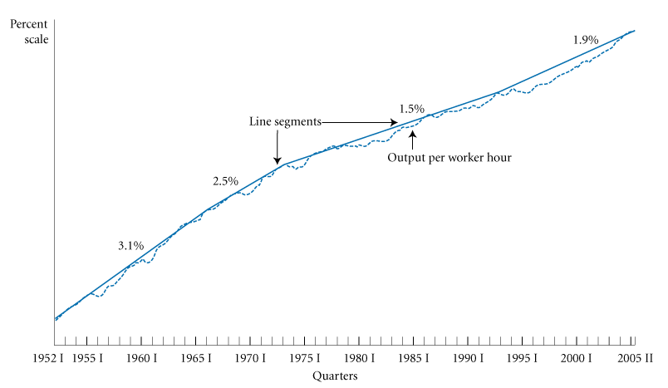
LONG-RUN OUTPUT AND PRODUCTIVITY GROWTH
FIGURE 7.1 Output per Worker Hour (Productivity), 1952 I–2005 II

Slide 5
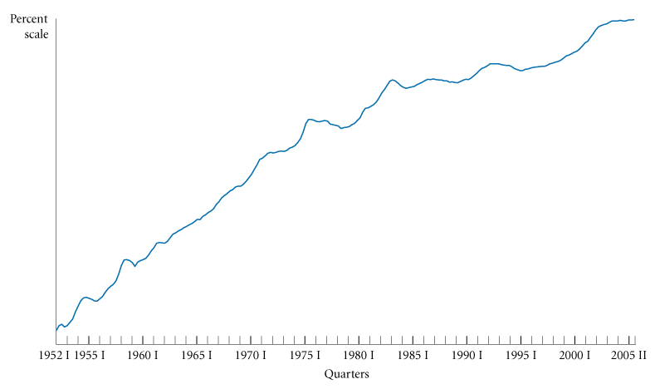
LONG-RUN OUTPUT AND PRODUCTIVITY GROWTH
FIGURE 7.2 Capital per Worker, 1952 I–2005 II

Slide 6
RECESSIONS, DEPRESSIONS, AND UNEMPLOYMENT
recession Roughly, a period in which real GDP declines for at least two consecutive quarters. Marked by falling output and rising unemployment.
depression A prolonged and deep recession. The precise definitions of prolonged and deep are debatable.

Slide 7
RECESSIONS, DEPRESSIONS, AND UNEMPLOYMENT
TABLE 7.1 Real GDP and Unemployment Rates, 1929–1933 and 1980–1982
THE EARLY PART OF THE GREAT DEPRESSION, 1929–1933
YEAR | PERCENTAGE CHANGE IN REAL GDP |  | UNEMPLOYMENT RATE |  |  |  | NUMBER OF UNEMPLOYED (MILLIONS)
1929 |  |  | 3.2 |  |  |  | 1.5
1930 | −8.6 |  | 8.9 |  |  |  | 4.3
1931 | −6.4 |  | 16.3 |  |  |  | 8.0
1932 | −13.0 |  | 24.1 |  |  |  | 12.1
1933 | −1.4 |  | 25.2 |  |  |  | 12.8
Note: Percentage fall in real GDP between 1929 and 1933 was 26.6 percent.
THE RECESSION OF 1980–1982
YEAR | PERCENTAGE CHANGE IN REAL GDP |  | UNEMPLOYMENT RATE |  | NUMBER OF UNEMPLOYED (MILLIONS) |  | CAPACITY UTILIZATION (PERCENTAGE)
1979 |  |  | 5.8 |  | 6.1 |  | 85.2
1980 | −0.2 |  | 7.1 |  | 7.6 |  | 80.9
1981 | 2.5 |  | 7.6 |  | 8.3 |  | 79.9
1982 | −1.9 |  | 9.7 |  | 10.7 |  | 72.1
Note: Percentage increase in real GDP between 1979 and 1982 was 0.1 percent. Sources: Historical Statistics of the United States and U.S. Department of Commerce, Bureau of Economic Analysis.

Slide 8
RECESSIONS, DEPRESSIONS, AND UNEMPLOYMENT
DEFINING AND MEASURING UNEMPLOYMENT
employed Any person 16 years old or older (1) who works for pay, either for someone else or in his or her own business for 1 or more hours per week; (2) who works without pay for 15 or more hours per week in a family enterprise; or (3) who has a job but has been temporarily absent, with or without pay.

Slide 9
RECESSIONS, DEPRESSIONS, AND UNEMPLOYMENT
unemployed A person 16 years old or older who is not working, is available for work, and has made specific efforts to
find work during the previous 4 weeks.
not in the labor force A person who is not looking for work, because he or she either does not want a job or has given
up looking.

Slide 10
RECESSIONS, DEPRESSIONS, AND UNEMPLOYMENT
labor force The number of people employed plus the number of unemployed.
labor force = employed + unemployed
population = labor force + not in labor force

Slide 11
RECESSIONS, DEPRESSIONS, AND UNEMPLOYMENT
unemployment rate The ratio of the number of people unemployed to the total number of people in the labor force.
labor force participation rate The ratio of the labor force to the total population 16 years old or older.

Slide 12
RECESSIONS, DEPRESSIONS, AND UNEMPLOYMENT
TABLE 7.2 Employed, Unemployed, and the Labor Force, 1953–2004
 | (1) |  | (2) |  | (3) |  | (4) |  | (5) |  | (6)
 | POPULATION 16 YEARS OLD OR OVER (MILLIONS) |  | LABOR FORCE (MILLIONS) |  | EMPLOYED (MILLIONS) |  | UNEMPLOYED (MILLIONS) |  | LABOR FORCE PARTICIPATION RATE |  | UNEMPLOYMENT RATE
1953 | 107.1 |  | 63.0 |  | 61.2 |  | 1.8 |  | 58.9 |  | 2.9
1960 | 117.2 |  | 69.6 |  | 65.8 |  | 3.9 |  | 59.4 |  | 5.5
1970 | 137.1 |  | 82.8 |  | 78.7 |  | 4.1 |  | 60.4 |  | 4.9
1980 | 167.7 |  | 106.9 |  | 99.3 |  | 7.6 |  | 63.8 |  | 7.1
1982 | 172.3 |  | 110.2 |  | 99.5 |  | 10.7 |  | 64.0 |  | 9.7
1990 | 189.2 |  | 125.8 |  | 118.8 |  | 7.0 |  | 66.5 |  | 5.6
2000 | 212.6 |  | 142.6 |  | 136.9 |  | 5.7 |  | 67.1 |  | 4.0
2004 | 223.4 |  | 147.4 |  | 139.3 |  | 8.1 |  | 66.0 |  | 5.5
Note: Figures are civilian only (military excluded). Source: Economic Report of the President, 2005, Table B-35.

Slide 13
RECESSIONS, DEPRESSIONS, AND UNEMPLOYMENT
COMPONENTS OF THE UNEMPLOYMENT RATE
Unemployment Rates for Different Demographic Groups
TABLE 7.3 Unemployment Rates by Demographic Group, 1982 and 2005
 |  | YEARS |  | NOVEMBER 1982 |  | JULY 2005
Total |  |  |  | 10.8 |  | 5.2
White |  |  |  | 9.6 |  | 4.4
 | Men |  | 20+ | 9.0 |  | 3.4
 | Women |  | 20+ | 8.1 |  | 4.3
 | Both sexes |  | 16–19 | 21.8 |  | 13.4
African-American |  |  |  | 20.2 |  | 10.2
 | Men Women |  | 20+ 20+ | 19.3 16.5 |  | 8.3 8.9
 | Both sexes |  | 16–19 | 51.1 |  | 36.4
Source: U.S. Department of Labor, Bureau of Labor Statistics. Data are not seasonally adjusted.
There are large differences in unemployment rates across demographic groups.

Slide 14
RECESSIONS, DEPRESSIONS, AND UNEMPLOYMENT
Unemployment Rates in States and Regions
TABLE 7.4 Regional Differences in Unemployment, 1975, 1982, 1991, and 2003
 | 1975 |  | 1982 |  | 1991 |  | 2003
U.S. avg. | 8.5 |  | 9.7 |  | 6.7 |  |  | 6.0
Cal. | 9.9 |  | 9.9 |  | 7.5 |  |  | 6.7
Fla. | 10.7 |  | 8.2 |  | 7.3 |  |  | 5.1
Ill. | 7.1 |  | 11.3 |  | 7.1 |  |  | 6.7
Mass. | 11.2 |  | 7.9 |  | 9.0 |  |  | 5.8
Mich. | 12.5 |  | 15.5 |  | 9.2 |  |  | 7.3
N.J. | 10.2 |  | 9.0 |  | 6.6 |  |  | 5.9
N.Y. | 9.5 |  | 8.6 |  | 7.2 |  |  | 6.3
N.C. | 8.6 |  | 9.0 |  | 5.8 |  |  | 6.5
Ohio | 9.1 |  | 12.5 |  | 6.4 |  |  | 6.1
Tex. | 5.6 |  | 6.9 |  | 6.6 |  |  | 6.8
Sources: Statistical Abstract of the United States, various editions.
The national unemployment rate does not tell the whole story. A low national rate of
unemployment does not mean that the entire nation is growing and producing at the
same rate.

Slide 15
RECESSIONS, DEPRESSIONS, AND UNEMPLOYMENT
Discouraged-Worker Effects
discouraged-worker effect The decline in the measured unemployment rate that results when people who want to work but cannot find jobs grow discouraged and stop looking, thus dropping out of the ranks of the unemployed and the labor force.

Slide 16
RECESSIONS, DEPRESSIONS, AND UNEMPLOYMENT
The Duration of Unemployment
TABLE 7.5 Average Duration of Unemployment, 1979–2004
 | WEEKS |  | WEEKS
1979 | 10.8 | 1992 | 17.7
1980 | 11.9 | 1993 | 18.0
1981 | 13.7 | 1994 | 18.8
1982 | 15.6 | 1995 | 16.6
1983 | 20.0 | 1996 | 16.7
1984 | 18.2 | 1997 | 15.8
1985 | 15.6 | 1998 | 14.5
1986 | 15.0 | 1999 | 13.4
1987 | 14.5 | 2000 | 12.6
1988 | 13.5 | 2001 | 13.1
1989 | 11.9 | 2002 | 16.6
1990 | 12.0 | 2003 | 19.2
1991 | 13.7 | 2004 | 19.6
Sources: U.S. Department of Labor, Bureau of Labor Statistics.

Slide 17
RECESSIONS, DEPRESSIONS, AND UNEMPLOYMENT
THE COSTS OF UNEMPLOYMENT
Some Unemployment Is Inevitable
When we consider the various costs of unemployment, it is useful to categorize unemployment into three types:
■ Frictional unemployment
■ Structural unemployment
■ Cyclical unemployment

Slide 18
RECESSIONS, DEPRESSIONS, AND UNEMPLOYMENT
Frictional and Structural Unemployment
frictional unemployment The portion of unemployment that is due to the normal working of the labor market; used to denote short-run job/skill matching problems.
structural unemployment The portion
of unemployment that is due to changes in the structure of the economy that result in a significant loss of jobs in certain industries.

Slide 19
RECESSIONS, DEPRESSIONS, AND UNEMPLOYMENT
natural rate of unemployment The
unemployment that occurs as a normal part of the functioning of the economy. Sometimes taken as the sum of frictional
unemployment and structural unemployment.

Slide 20
RECESSIONS, DEPRESSIONS, AND UNEMPLOYMENT
Cyclical Unemployment and Lost Output
cyclical unemployment The increase in unemployment that occurs during recessions and depressions.

Slide 21
RECESSIONS, DEPRESSIONS, AND UNEMPLOYMENT
Social Consequences
In addition to economic hardship, prolonged unemployment may also bring with it social and personal
ills: anxiety, depression, deterioration of physical and psychological health, drug abuse (including alcoholism), and suicide.

Slide 22
RECESSIONS, DEPRESSIONS, AND UNEMPLOYMENT
THE BENEFITS OF RECESSIONS
TABLE 7.6 Inflation Rates, 1974–1976 and 1980–1983
RECESSION BEGINS | INFLATION RATE
1974 | 11.0
1975 | 9.1
1976 | 5.8
1980 | 13.5
1981 | 10.3
1982 | 6.2
1983 | 3.2
Source: See Table 17.8.
Recessions may help to reduce inflation.

Slide 23
INFLATION
TABLE 7.7 Inflation During Three Expansions
 | INFLATION RATE
1972 | 3.2
1973 | 6.2
1974 | 11.0
1976 | 5.8
1977 | 6.5
1978 | 7.6
1979 | 11.3
1980 | 13.5
1984 | 4.3
1985 | 3.6
1986 | 1.9
1987 | 3.6
1988 | 4.1
1989 | 4.8
Source: See Table 7.8.

Slide 24
INFLATION
DEFINING INFLATION
inflation An increase in the overall price level.
deflation A decrease in the overall price level.
sustained inflation An increase in the overall price level that continues over a significant period.

Slide 25
INFLATION
PRICE INDEXES
consumer price index (CPI) A price index computed each month by the Bureau of Labor Statistics using a bundle that is meant to represent the
“market basket” purchased monthly by the typical urban consumer.

Slide 26
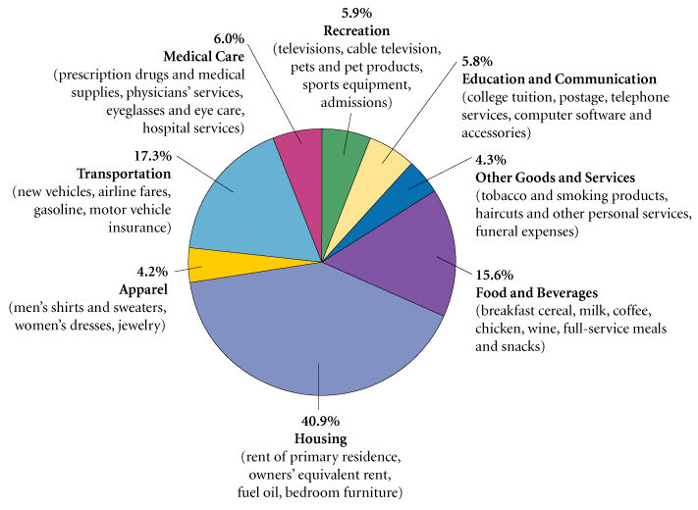
INFLATION
FIGURE 7.3 The CPI Market Basket

Slide 27
INFLATION
TABLE 7.8 The CPI, 1950–2004
 | PERCENTAGE CHANGE IN CPI | CPI |  | PERCENTAGE CHANGE IN CPI | CPI |  | PERCENTAGE CHANGE IN CPI | CPI
1950 | 1.3 | 24.1 | 1968 | 4.2 | 34.8 | 1986 | 1.9 | 109.6
1951 | 7.9 | 26.0 | 1969 | 5.5 | 36.7 | 1987 | 3.6 | 113.6
1952 | 1.9 | 26.5 | 1970 | 5.7 | 38.8 | 1988 | 4.1 | 118.3
1953 | 0.8 | 26.7 | 1971 | 4.4 | 40.5 | 1989 | 4.8 | 124.0
1954 | 0.7 | 26.9 | 1972 | 3.2 | 41.8 | 1990 | 5.4 | 130.7
1955 | −0.4 | 26.8 | 1973 | 6.2 | 44.4 | 1991 | 4.2 | 136.2
1956 | 1.5 | 27.2 | 1974 | 11.0 | 49.3 | 1992 | 3.0 | 140.3
1957 | 3.3 | 28.1 | 1975 | 9.1 | 53.8 | 1993 | 3.0 | 144.5
1958 | 2.8 | 28.9 | 1976 | 5.8 | 56.9 | 1994 | 2.6 | 148.2
1959 | 0.7 | 29.1 | 1977 | 6.5 | 60.6 | 1995 | 2.8 | 152.4
1960 | 1.7 | 29.6 | 1978 | 7.6 | 65.2 | 1996 | 3.0 | 156.9
1961 | 1.0 | 29.9 | 1979 | 11.3 | 72.6 | 1997 | 2.3 | 160.5
1962 | 1.0 | 30.2 | 1980 | 13.5 | 82.4 | 1998 | 1.6 | 163.0
1963 | 1.3 | 30.6 | 1981 | 10.3 | 90.9 | 1999 | 2.2 | 166.6
1964 | 1.3 | 31.0 | 1982 | 6.2 | 96.5 | 2000 | 3.4 | 172.2
1965 | 1.6 | 31.5 | 1983 | 3.2 | 99.6 | 2001 | 2.8 | 177.1
1966 | 2.9 | 32.4 | 1984 | 4.3 | 103.9 | 2002 | 1.6 | 179.9
1967 | 3.1 | 33.4 | 1985 | 3.6 | 107.6 | 2003 | 2.3 | 184.0
 |  |  |  |  |  | 2004 | 2.7 | 188.9
Sources: Bureau of Labor Statistics, U.S. Department of Labor.
Changes in the CPI somewhat overstate changes in the cost of living.

Slide 28
INFLATION
producer price indexes (PPIs) Measures of prices that producers receive for products at all stages in the production process.
The three main categories are finished goods, intermediate materials, and crude materials, although there are subcategories within each of these categories.

Slide 29
INFLATION
THE COSTS OF INFLATION
People’s income from wages and salaries, profits, interest, and rent increases during inflations. The wage rate is the price of labor, rent is the price of land, and so on. During inflations, most prices—including input prices—tend to rise together, and input prices determine both the incomes of workers and the incomes of owners of capital and land.

Slide 30
INFLATION
Inflation Changes the Distribution of Income
If your income is fixed and prices rise, your
ability to purchase goods and services falls proportionately.
Effects on Debtors and Creditors
real interest rate The difference between the interest rate on a loan and the inflation rate.
Inflation that is higher than expected benefits debtors; inflation that is lower than expected benefits creditors.

Slide 31
INFLATION
Administrative Costs and Inefficiencies
Inflation creates administrative costs and inefficiencies. Without inflation, time could be used more efficiently.
The opportunity cost of holding cash is high during inflations. People therefore hold less cash and need to stop at the bank more often.
People are not fully informed about price changes and may make mistakes that lead to a misallocation of resources.

Slide 32
INFLATION
Increased Risk and Slower Economic Growth
When unanticipated inflation occurs regularly, the degree of risk associated with investments in the economy increases.

Slide 33
INFLATION
INFLATION: PUBLIC ENEMY NUMBER ONE?
Some people consider inflation to be our public enemy number one. Elected leaders have vigorously pursued policies designed to stop inflation.
The recessions of 1974 to 1975 and 1980 to 1982 were the price we had to pay to stop inflation. Stopping inflation is costly.

Slide 34
REVIEW TERMS AND CONCEPTS
consumer price index (CPI)
cyclical unemployment
deflation
depression
discouraged-worker effect
employed
frictional unemployment
inflation
labor force
labor force participation rate
natural rate of unemployment
not in the labor force
output growth
per-capita output growth
producer price indexes (PPIs)
productivity growth
real interest rate
recession
structural unemployment
sustained inflation
unemployed
unemployment rate
1. Labor force = employed + unemployed
2. Population = labor force + not in labor force
3.
4.

